Slide 1
Turner Classic Movies
Modern Hits to Classic Recommendations

Slide 2

Wes Smolen
Data Scientist
Environmental Science at Univ. of Colo
Sales and Hospitality
github.com/WSmolen
wjsmolen@gmail.com
linkedin.com/in/wes-smolen

Slide 3
Agenda
01
02
03
04
05
06
Business Overview
Main Takeaway
Data Overview
Data Analysis
Recommendations
Insights

Slide 4
01
Business Overview

Slide 5
Business Overview
Turner Classic Movies
Annual Revenue of $200 Million.
Budget of $20-40 Million.
Movies Mostly From The 30s Through 60s
2022 Warner Bros. Discovery Merger
Streaming Platforms Offer New Challenges and Opportunities

Slide 6
02
Main Takeaway

Slide 7
New movies are the perfect gateway to Turner Classic Movies
Machine Learning Can Make New Classic!

Slide 8
03
Data Overview

Slide 9
Data Overview
Movielens.org
25 Million Ratings
62,000 movies
162,000 Users
Up to December, 2019
Golden Era to Modern
Recommended Films from 1927-1969 for TCM
Using User Ratings of Modern Films: 2017-2019

Slide 10
04
Data Analysis

Slide 11
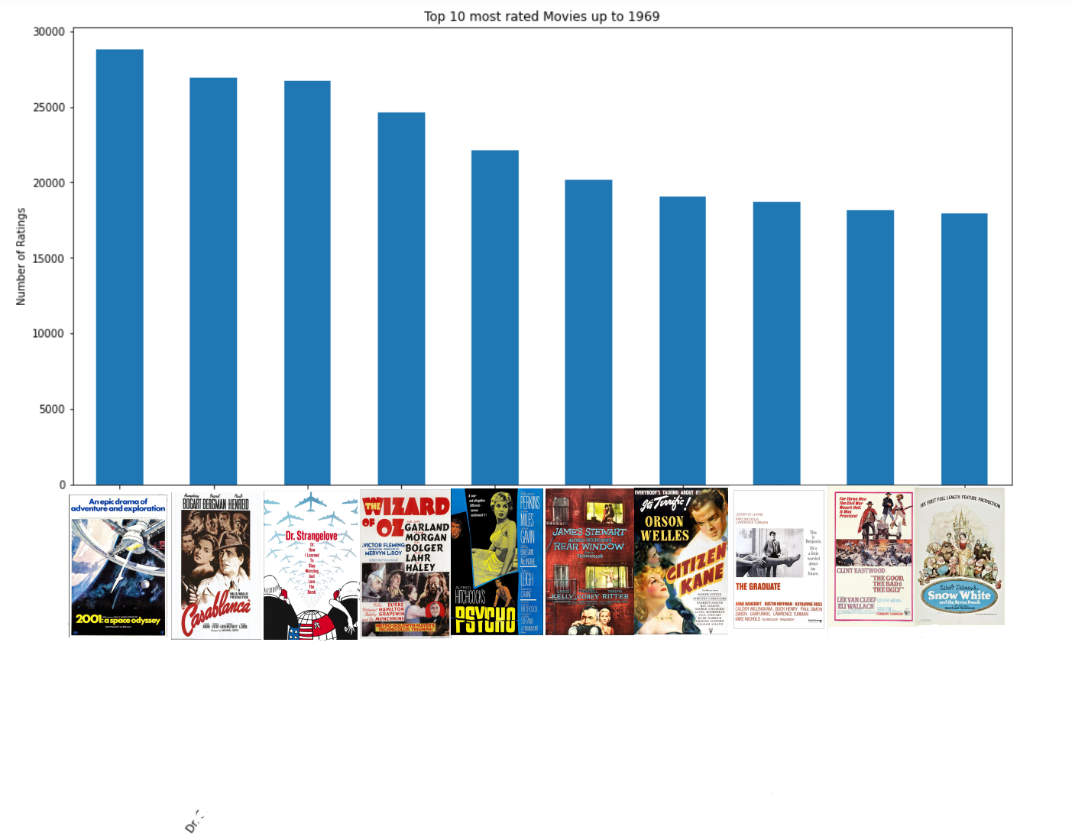
Most Rated Movies May Bias Recommendations

Slide 12
Model Comparison
 | RMSE | MAE
KNN Basic | .903 | .674
KNN Baseline | .869 | .647
NMF | .858 | .663
SVD | .827 | .632

Slide 13





Drama Recommendations
Rating = 5
Rating = 5
(1957)
Rating = 5
(1954)

Slide 14





Comedy Recommendations
Rating = 5
Rating = 5
(1964)
Rating = 5
(1965)

Slide 15





Mixed Ratings and Genres Recommendations
Rating = 5
Rating = 3
(1963)
Rating = 5
(1965)

Slide 16





Mixed Recommendations
Rating = 4
Rating = 2
We Only Live Once (1958)
Rating = 5
The Plea (1967)

Slide 17
05
Recommendations

Slide 18
Turn new hits into TCM engagement
Integrate this model on Max streaming platform

Slide 19
06
Insights

Slide 20
Future Insights
Include New Releases
Expand Features
Data Analyzed up to Dec. 2019
Foreign Films, Genres, Principals
Extend “Classic”
70s and 80s Films
Acquire Recommended Films
Cost/Benefit Analysis of Licensing Fees

Slide 21
THANKS!
DO YOU HAVE ANY QUESTIONS?
wjsmolen@gmail.com
github.com/WSmolen
linkedin.com/in/wes-smolen

